Slide 1


Question: What is Secure Envelope?
Answer: DARS will utilizes a Cisco product called Cisco Registered Envelope Service (CRES) to provide Secure Email services for transmission of authorizations via a secure email method to email users external to DARS email system.

Slide 2
Step-by-Step Guide to Opening Your First Envelope
This section provides step-by-step instructions for opening a Registered Envelope for the first time. The steps and supporting graphics demonstrate the typical scenario for a first-time recipient. Some of the steps may vary, depending on the particular circumstances.
Note: These steps apply to first-time recipients only. After you enroll with Cisco Registered Envelope Service, you can use your password to open envelopes from any sender.

Slide 3
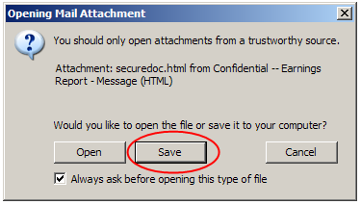
Step One: Save the securedoc.html File Attachment to Your Hard Drive
When you receive a Registered Envelope notification message, you need to open the securedoc.html file attachment to view the Registered Envelope. For best results, double-click the securedoc.html file and save it to your hard drive before opening it, as shown here.
Note: The dialog box for saving an attachment may look different, depending on your email program, or if you use a web mail site, such as Yahoo! Mail, Gmail, or Hotmail.

Slide 4
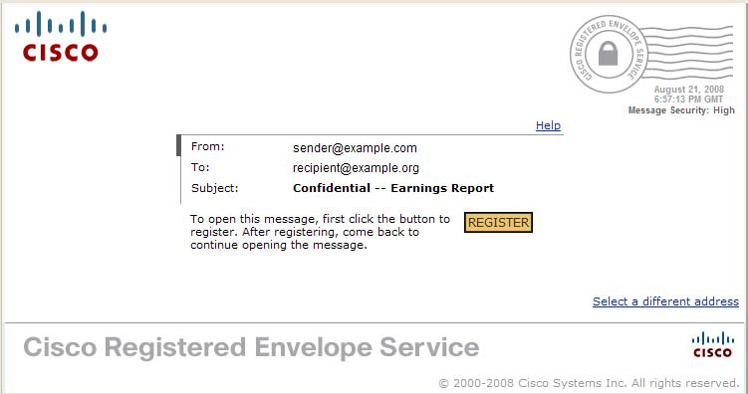
Step Two: Open the securedoc.html File in a Web Browser
Open the securedoc.html file in a web browser, such as Microsoft Internet Explorer or Mozilla Firefox. The Registered Envelope is displayed.

Slide 5
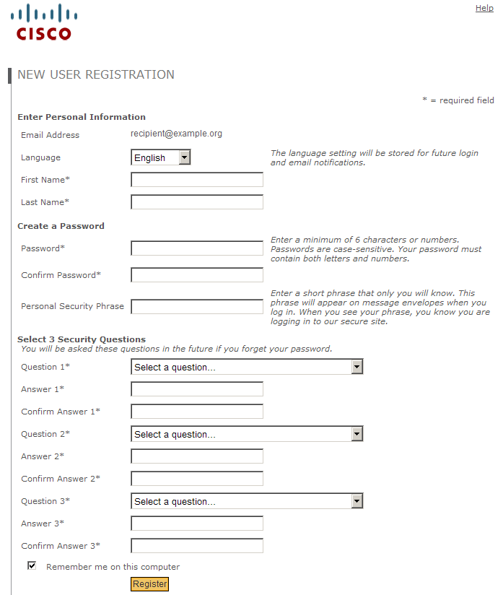
Step Three: Click the Register Button to Enroll with the Service
Click the Register button on the Registered Envelope to enroll with Cisco Registered Envelope Service.
The New User Registration page is displayed.
Complete the online registration form and click the Register button at the bottom of the page to create a user account. There is no charge to enroll with and use the service.

Slide 6
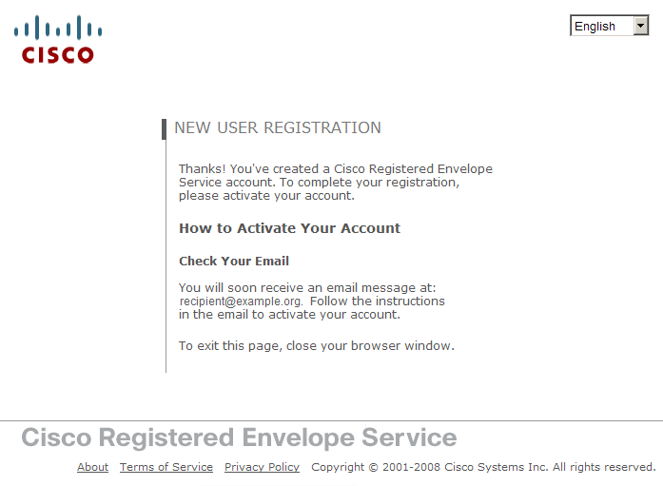
After you complete the form and click Register, the following confirmation page is displayed.
You may need to set up more than one user account if you receive Registered Envelopes at multiple email addresses. You need a separate user account for each address.

Slide 7
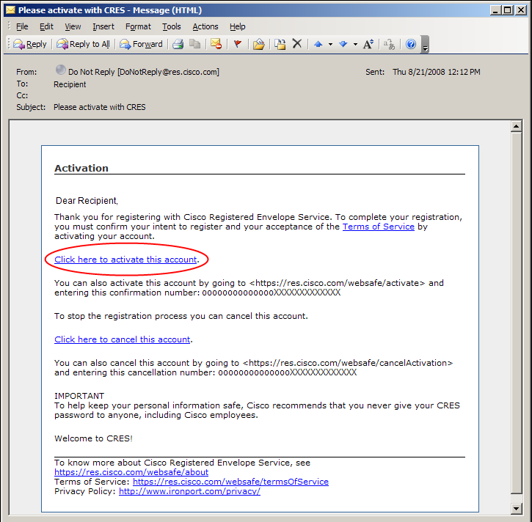
Step Four: Activate Your Cisco Registered Envelope Service Account
Check your email inbox for an activation message from the service. The following example shows a typical activation message.
In the activation email message, click the link to activate your user account.

Slide 8
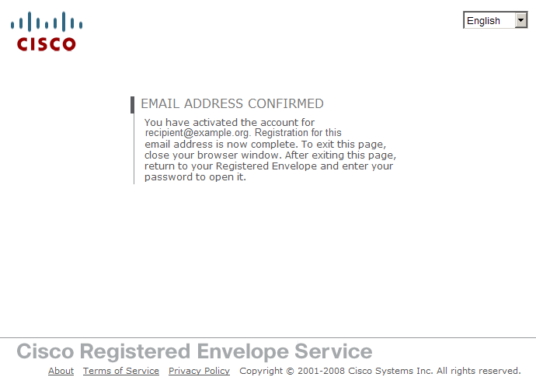
The following confirmation page is displayed.

Slide 9
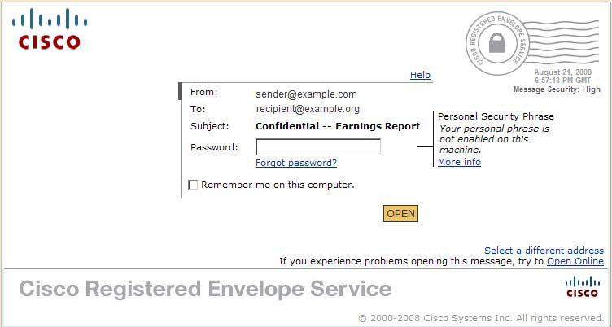
Step Five: View the Registered Envelope Again and Enter Your Password
View the Registered Envelope. The Register button is no longer displayed on the envelope. An Open button appears in its place, as shown here.
Enter the password for your Cisco Registered Envelope Service user account,
and click Open.

Slide 10
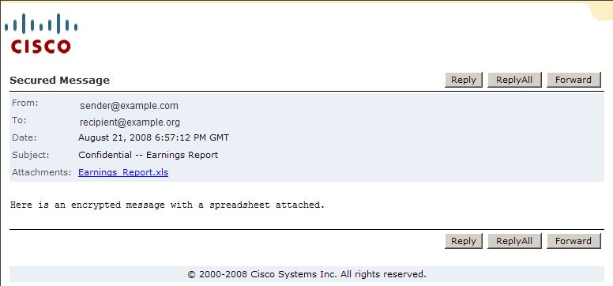
The decrypted message is displayed in the browser window.
After you open a Registered Envelope, you can click Reply to send a Secure Reply message or click Forward to send a Secure Forward message. When you send a Secure Reply or Secure Forward message, the recipient receives a Registered Envelope containing the encrypted message.

Slide 11

Secure Envelope FAQs

Slide 12
Question: In a nutshell how does the process work?
Answer: Generally speaking, a DARS employee initiates a secure email. This tells CRES and the recipient you are sending a message to, that the email contains confidential information and thus should be encrypted. The DARS email will then encrypt the email and send it to the CRES email servers on the Internet.
Note: There will be no confidential information in the subject line of your email.

Slide 13
Question: Are there any limitations on the number of DARS employees who can send Secure Email?
Answer: No. All DARS field staff will be sending information in a secure format.

Slide 14
Question: Are there any restrictions on what can actually be sent or disclosed through Secure Email?
Answer: Yes. All PHI, PII & Sensitive Data will be sent via Secure Email.

Slide 15
Question: Is there a Secure Email pre-registration component available to business partners?
Answer: No. It is not required to pre-register prior to receiving Secure Email.

Slide 16
Question: When DARS users send a Secure Email, is the Secure Email protected or excluded from Virginia Freedom of Information Act (FOIA) requests?
Answer: No. Secure Email does not fall in the same classifications as Governor’s working papers, Records of the Virginia Department of Emergency Management (DEM), or Applications to the Virginia Department of Health Professionals (DHP).

Slide 17
Question: If two DARS employees send a Secure Email to the same person at another agency or company, will the receiver have to register twice?
Answer: No. As long as the receiver of the Secure Email message has the same email address registered in the CRES Secure Email system, they will only need to be registered once to receive any secured messages addressed to them.

Slide 18
Question: If the receiver saves a Secure Email in their Secure Mailbox, will the Secure Email still automatically delete after 30 days?
Answer: No. According to CRES communications, the Secure Email stays on the CRES server for one year. The receiver must copy or save the email and/or attachment to their local storage area, i.e., their c:drive or somewhere on their local network if they want to retain for a longer period.

Slide 19
Question: Is there a re-registration prompt (email notification) sent to a registrant if they have not used the DARS Secure Email system for one year.
Answer: No. The registrant will not receive any notification warning.

Slide 20
Question: How do I know that my recipient read the message that I sent them?
Answer: When the recipient reads the secure email message that was sent, the DARS sender will get a message from CRES. This message lets the DARS sender know that the recipient has read the secure message.

Slide 21
Question: When I receive a Secure Email with an attachment, after I put in my password I see the browser says "Loading Envelope Tools..." What do I do?
Answer: There are two choices:
Wait a few minutes and the item and attachment will finally load.
OR
Click on the link that says “If you experience problems opening this message, try to Open Online” and bypass the downloading delay.

Slide 22
Question: If multiple receivers get a Secure Email from DARS, will all those copied or cc’d on the Secure Email receive the original message and also be able to reply to everyone that was cc’d?
Answer: Yes. They will need to register before they can view the original message.

Slide 23
Question: Once the receiver gets the Secure Email, can the receiver forward it to someone within their organization or a different email address?
Answer: Yes. The receiver of the email message can reply to the original message from the DARS sender or forward the message to any other mail recipient.

Slide 24
Question: If a Secure Email is received by an individual, what prevents the receiver from cutting and pasting the content of the message to another Email and forwarding it to another individual?
Answer: Similar to regular email, Secure Email does not prevent anyone from cutting and pasting the content of the message.

Slide 25
Question: What if the secure email recipient forgets their password?
Answer: If the secure email recipient forgets their password when they attempt to login, there are several ways to retrieve their password.
The “Personal Security Phrase” that shows on the CRES logon screen is the password hint the users added during registration.
If the user still cannot remember their password, they can click on the “Forgot Password?” link to start the process of securely resetting their password.

Slide 26
Question: What are the external user account properties ?
Answer: There are 5 settings:
Password Policy: Minimum of 6 characters with at least one number.
Account Lockout: User accounts are disabled after 5 unsuccessful logon attempts.
Inactivity Policy: Users are logged out of CRES after 10 minutes of inactivity in the secure web browser.
Message Expiration: User email messages on CRES expire after one year.
User Account Status: User accounts are on CRES are good for one year. After one year of inactivity, the account will be auto-deleted with no warnings.

Slide 27
Question: When the recipient requests a new password, how long do they have to receive/change it?
Answer: When a recipient requests a new password, they will receive the temporary new password sent to their registered email address. They will have a 72-hour window in which to use this link to change their temporary password.

Slide 28
Question: What if my secure email recipient still has difficulty or cannot login?
Answer: If your Secure Email recipient has difficulty with CRES or cannot logon. The recipient must contact the originator (meaning the sender) of the Secure Email message at DARS and the Secure Email originator must send an email to VCCC at VCCC@vita.virginia.gov or call them at 1-866-637-8482. When they create the VCCC ticket, ask that the ticket be assigned to the Ironport team for assistance.
Be sure to include the name of your recipient who is having a problem and their email address and telephone number. The reason for this is to ensure that the VCCC only responds to valid recipient password problems, and only you, as the Secure Email originator, would know if the intended recipient is valid. The VCCC will work with the recipient to fix/resolve their password issue.

